Slide 1
Butterfly: Fun, Share Learn
CSE 3200: Software Development Project-II
SUPERVISED BY:
Mr. Jakaria Rabbi
Lecturer
Department of Computer Science and Engineering
Khulna University of Engineering & Technology, khulna-9203
Submitted by:
Md. Sharif Khan
Roll: 1307034
&&
Md. Jahirul Islam
Roll: 1307035

Slide 2
OVERVIEW
To connect people under a single platform
To keep user anonymous to ensure user confidentiality
To share knowledge with everyone
To make the world a better place

Slide 3
FEATURES
Annonymous Video viewing & uploading
For Like/Comment have to be user but user information will be classified
Popular videos
Topics wise video upload
Will be an open platform for all who want to express their will anonymously

Slide 4
BASE STRUCTURE
HTML5
PHP
CSS
MySQL

Slide 5
CONTROL FLOW
Normal VieweR
HOME Page
Video Page
Login/Signup

Slide 6
Signed user
Login
Signup
HOME Page
Upload Video
Video Page
Profile Page
Logout

Slide 7
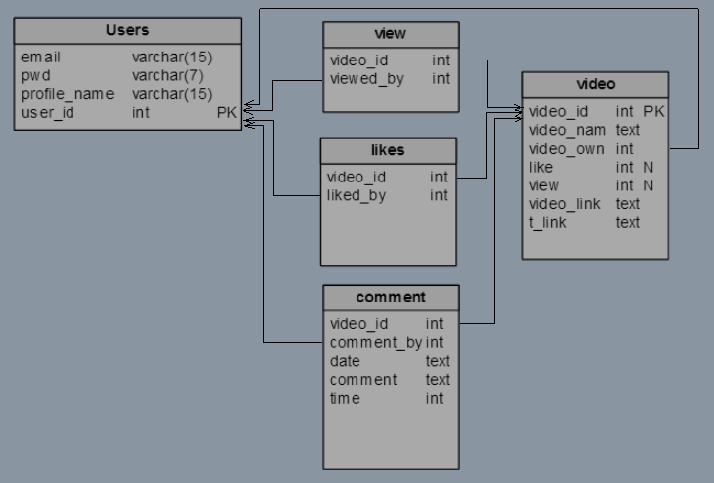
Database Design

Slide 8
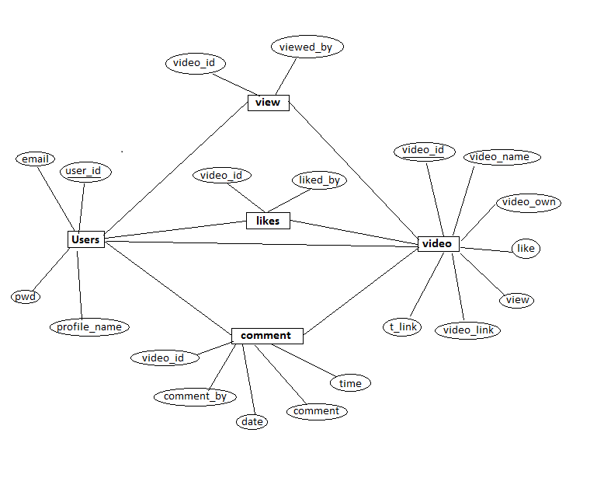
Database Block Diagram

Slide 9
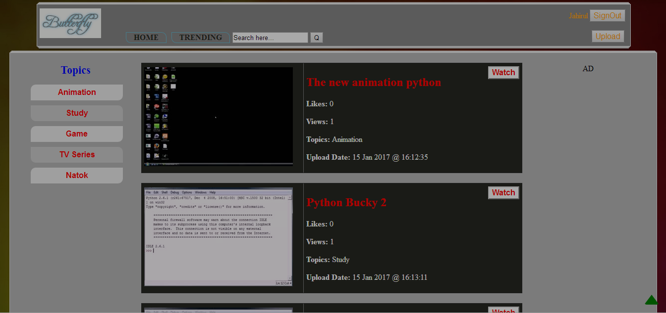
Interfaces 1 – Home Page

Slide 10
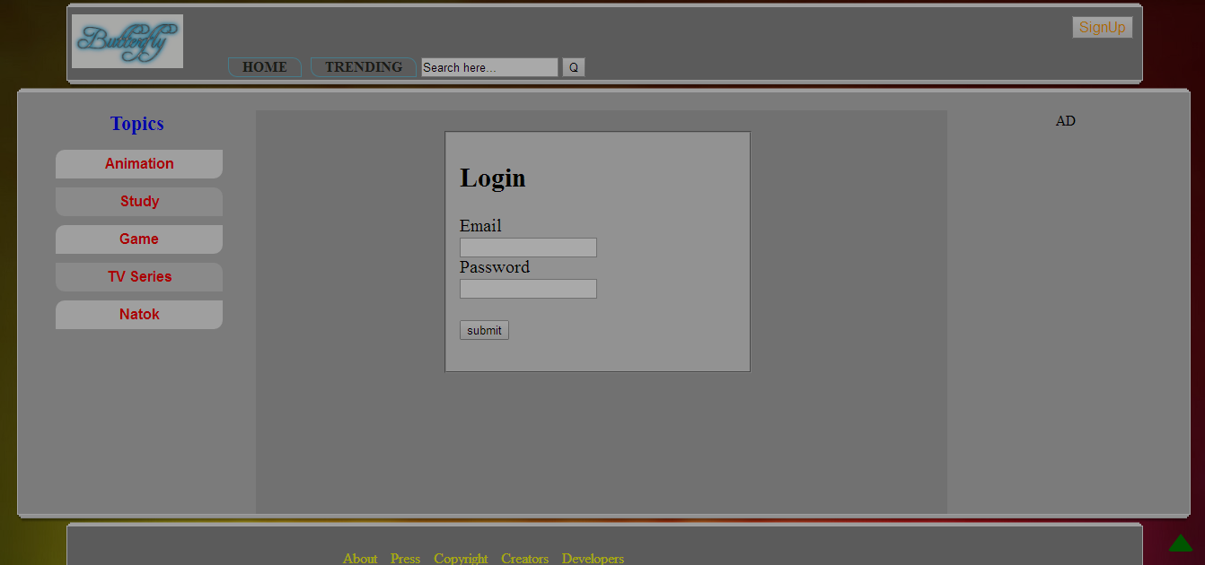
Interfaces 2 – Login Page

Slide 11
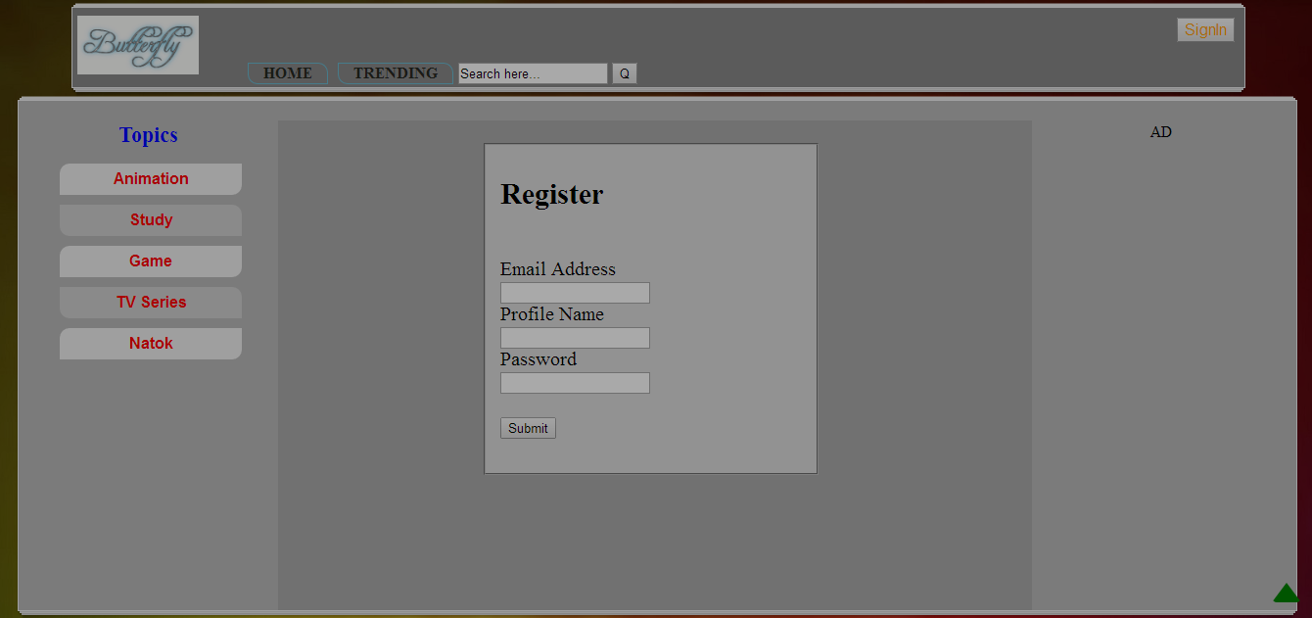
Interfaces 3 – Register Page

Slide 12
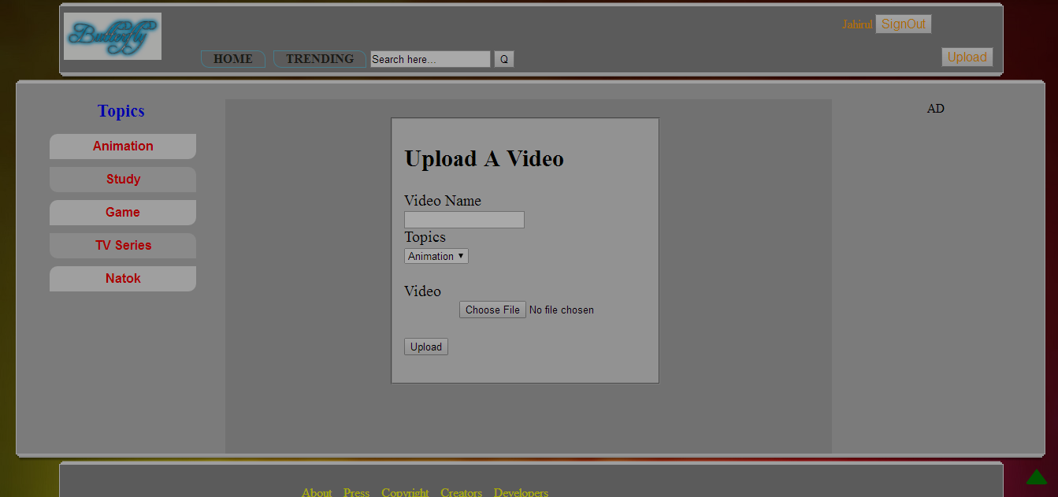
Interfaces 4 – Upload Video

Slide 13
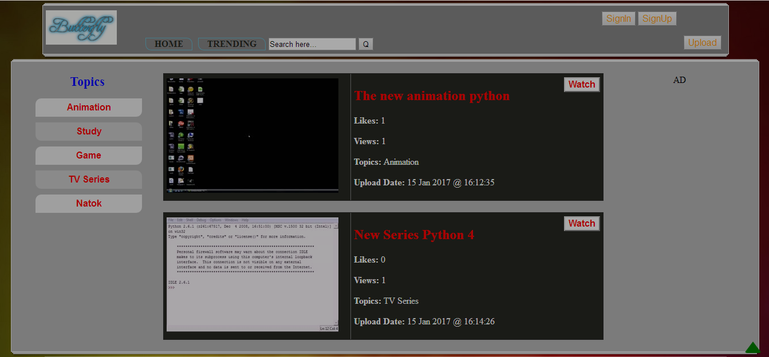
Interfaces 5 – Search Result

Slide 14
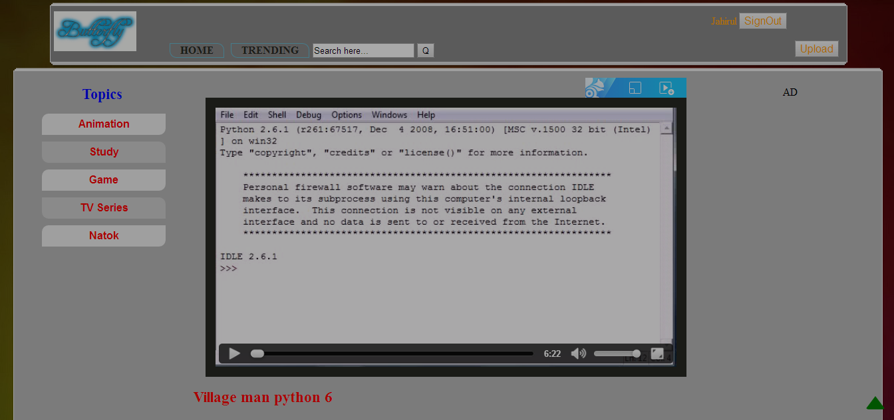
Interfaces 6 – Video Page

Slide 15
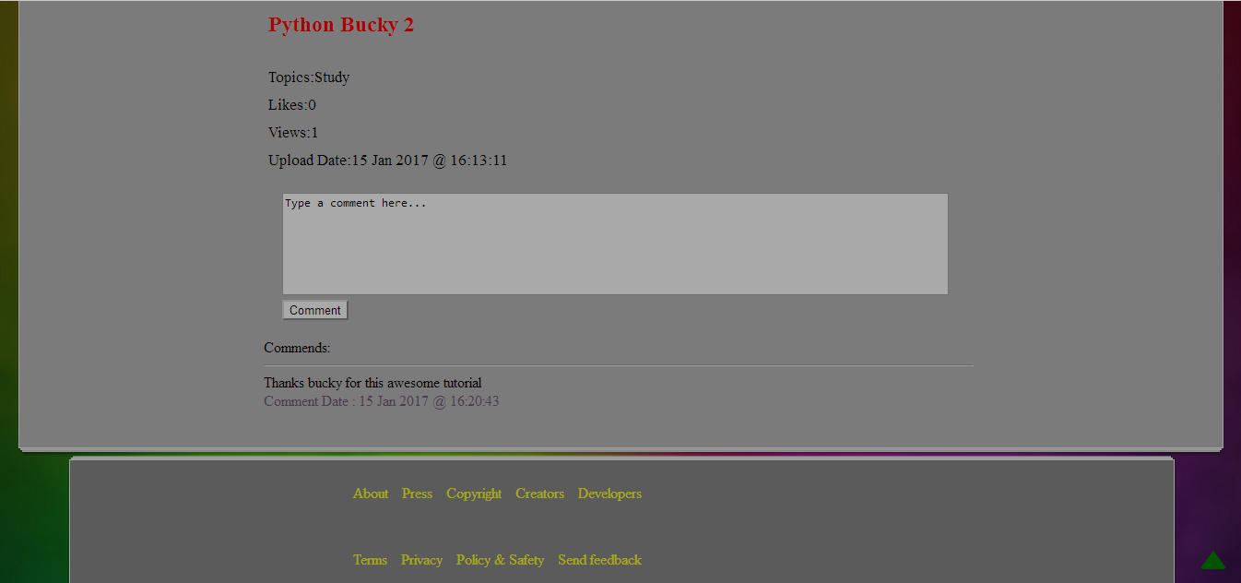
Interfaces 7 – Comment Page

Slide 16
LIMITATIONS
No playlist feature
No share option
Video player can be more customized
No AJAX used in search box
Interface can be more attractive
Etc.

Slide 17
FUTURE PLAN
Add playlist feature
Video suggestion
Share option
Customized video player

Slide 18
CONCLUTION
Butterfly is project (website) that is made for mainly uploading video with everyone and view others without exposed own identity. We know this was a very small part of main project. But this can be used in various option. So, we can speak our words by video as like a butterfly in the sky

Slide 19
REFERENCES
W3Schools Online Web Tutorials
TutorialsPoint
PHP: A simple tutorial - Manual
SQLCourse - Interactive Online SQL Training for Beginners
HTML5 Tutorial

Slide 20
THANK YOU

